Slide 1
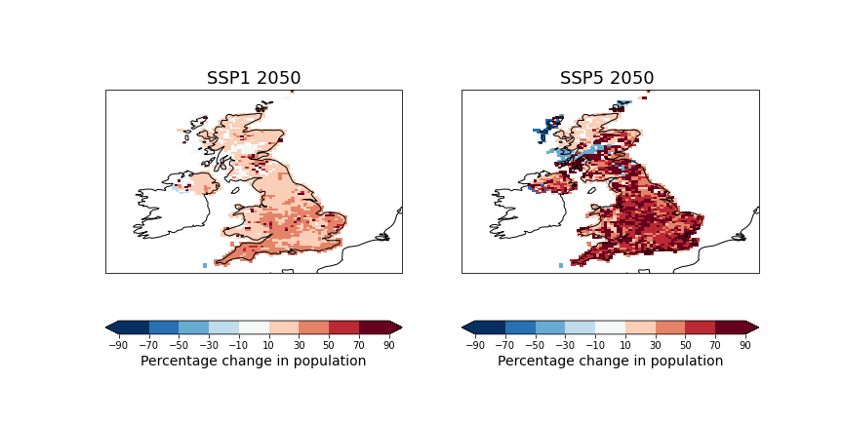
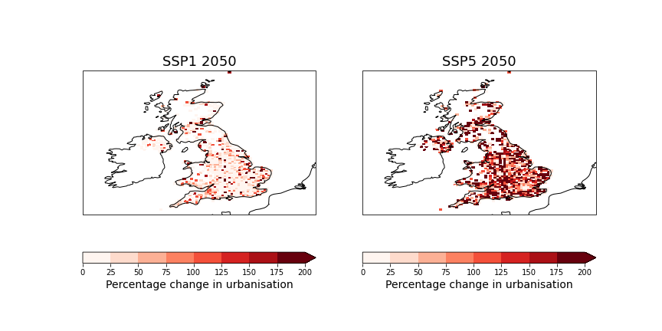
Team 4B: Understanding drivers of uncertainty in future loss projections
High hazard
Low
exposure
High
exposure
Low hazard
Outputs:
Maps of relevant SSP data
Scripts for applying exposure scaling
Data files for input to the catastrophe model
Paper

